Slide 1
Finding the Subnet, Broadcast and Useable Host Ranges
Lecture 7
CIDR

Slide 2
Introduction
Prior to 1981, IP addresses used only the first 8 bits to specify the network portion of the address
In 1981, RFC (Request for Comments)791 modified the IPv4 32-bit address to allow for three different classes
    Class A addresses used 8 bits for the network portion of the address,
    Class B used 16 bits,
    Class C used 24 bits.
  This format became known as classful IP addressing.

Slide 3
Solution
Classless Inter Domain Routing (CIDR) was announced in September 1993 and is documented in RFCs 1517, 1518, 1519, and 1520.
CIDR (often pronounced as “cider”) eliminates the traditional concept of Class A, B, and C addresses entirely.
The first 3 bits of the IP address, which have traditionally been used to determine address class, are meaningless.
Likewise first octet address ranges no longer indicate a particular address class.
Thus, CIDR allows a more efficient allocation of the remaining Internet IP addresses.

Slide 4
Implementation Requirement
CIDR addresses are issued in blocks known as CIDR blocks.
The only factor that determines the capacity of a CIDR block is the network prefix assigned by the Internet authorities when the CIDR block is issued.
Just as was the case with classful addressing, the network prefix issued by the Internet authorities indicates the number of bits used for the major network ID.

Slide 5
Cont.
These bits are reserved and cannot be used by the end users for subnet IDs or host IDs. For example, if a CIDR block was issued with a network prefix of /18, which would imply that the first 18 bits from left to right be reserved for the network ID.
This would leave 14 bits (32–18) for subnet IDs and host IDs.
Since 2 raised to the fourteenth power is 16,384, that is how many host IDs or individual addresses can be defined for a CIDR block with a network prefix of /18.
An important point to remember is that it doesn’t matter what the assigned major network ID is: All /18 CIDR blocks are equal in terms of capacity, regardless of network ID.

Slide 6
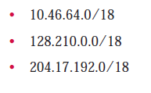
Cont.
This is where is becomes important to forget the traditional view of classful addressing.
As an example, the following three CIDR addresses are equivalent, even though they would not be equal from a classful addressing standpoint:

Slide 7
Number of Addresses in a Block
There is only one condition on the number of addresses in a block; it must be a power of 2 (2, 4, 8, . . .). A household may be given a block of 2 addresses. A small business may be given 16 addresses. A large organization may be given 1024 addresses.

Slide 8
CIDR Notation
CIDR notation of a network address:
192.0.2.0/18
    "18" says that the first 18 bits are the network part of the address (and 14 bits are available for specific host addresses)
The network part is called the prefix
Assume that an ISP owns the address block 206.0.64.0/18, which represents 16,384 (2³²⁻¹⁸=2¹⁴) IP addresses
Suppose a client requires 800 host addresses
(512=2⁹<800<1024=2¹⁰→32-10=22),e.g., 206.0.64.0/22 gives a block of 1,024 (2¹⁰) IP addresses.

Slide 9
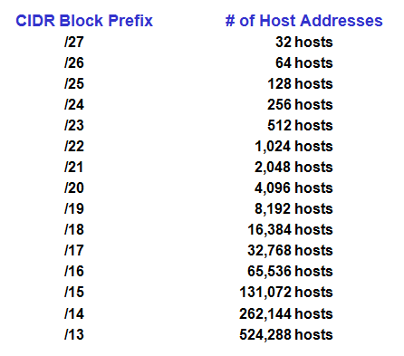
CIDR: Prefix Size vs. Host Space

Slide 10
P
PROBLEMS
A small organization is given a block with the beginning address and the prefix length 205.16.37.24/29 (in CIDR notation). What is the range of the block?
Solution
The length of the suffix is 32 - 29 or 3. So there are 2³ = 8 addresses in this block. If the first address is 205.16.37.24, the last address is 205.16.37.31 (24 + 7 = 31).

Slide 11
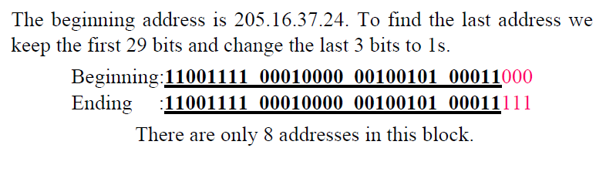
Solution

Slide 12
PROBLEMS
What is the network address if one of the addresses is 167.199.170.82/27? (What is the first address in the block if one of the addresses is 167.199.170.82/27?)
Solution
The prefix length is 27, which means that we must keep the first 27 bits as is and change the remaining bits (5) to 0s. The 5 bits affect only the last byte. The last byte is 01010010. Changing the last 5 bits to 0s, we get 01000000 or 64. The network address is 167.199.170.64/27.

Slide 13
PROBLEMS
What is the first address in the block if one of the address is 140.120.84.24/20?
Answer
The first address is 140.120.80.0/20

Slide 14
PROBLEMS
Find the number of addresses in the block if one of the addresses is 140.120.84.24/20.
Solution
The prefix length is 20. The number of addresses in the block is 2³²⁻²⁰ or 2¹² or 4096.

Slide 15
PROBLEMS
Find the last address in the block if one of the addresses is 140.120.84.24/20.
Answer
The first address is 140.120.80.0/20
The number of addresses in the block is 4096.
To find the last address, we need to add 4095 (4096-1) to the first address.

Slide 16

Answer-Cont.
To keep the format in dotted-decimal notation, we need to represent 4095 in base 256 and do the calculation in base 256. We write 4095 as 15.255. We then add the first address to this number (in base 255) to obtain the last address as shown below. (??)
The last address is 140.120.95.255/20

Slide 17
PROBLEMS
An organization is granted the block 130.34.12.64/26. The organization needs to have four subnets. What are the subnet addresses and the range of addresses for each subnet?
Solution
The suffix length is 6. This means the total number of addresses in the block is 64 (2⁶). If we create four subnets, each subnet will have 16 addresses.
Let us first find the subnet prefix . We need four subnets, which mean we need to add two more 1s to the site prefix. The subnet prefix is then /28.
Subnet 1: 130.34.12.64/28 to 130.34.12.79/28.
Subnet 2: 130.34.12.80/28 to 130.34.12.95/28.
Subnet 3: 130.34.12.96/28 to 130.34.12.111/28.
Subnet 4: 130.34.12.112/28 to 130.34.12.127/28.

Slide 18
PROBLEMS
Find the block if one of the addresses is 190.87.140.202/29.
Solution
The number of addresses is 2³²⁻²⁹ or 8.
The first address is 190.87.140.200/29
The last address is 190.87.140.207/29.

Slide 19
PROBLEMS
Show a network configuration for the block in the previous example.
Solution
The organization that is granted the block in the previous example can assign the addresses in the block to the hosts in its network.
However, the first address needs to be used as the network address and the last address is kept as a special address(limited broadcast address)

Slide 20
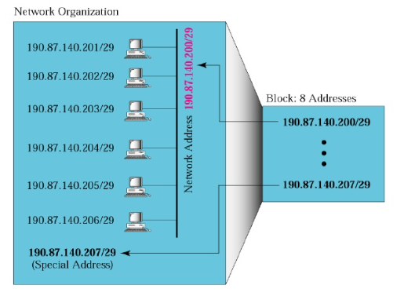
Cont.

Slide 21
Subnetting
When an organization is granted a block of addresses, it can create subnets to meet its needs.
The prefix length increases to define the subnet prefix length.
In fixed-length subnetting, the number of subnets is a power of 2.

Slide 22
PROBLEMS
An organization is granted the block 130.34.12.64/26. The organization needs to have four subnets. What is the subnet prefix length?
Solution
We need 4 subnets, which means we need to add two more 1s to the site prefix. The subnet prefix is then /28.

Slide 23
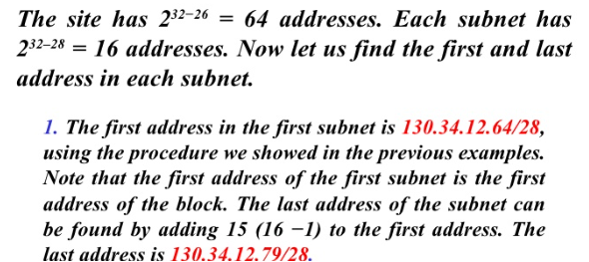
PROBLEMS
What are the subnet addresses and the range of addresses for each subnet in the previous example?
Solution

Slide 24
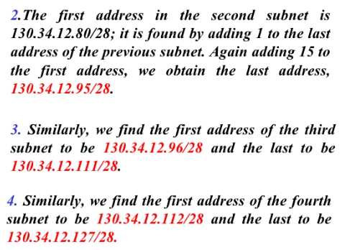
Cont.

Slide 25
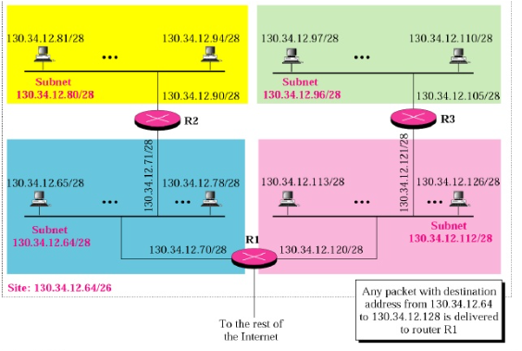
Cont.

Slide 26
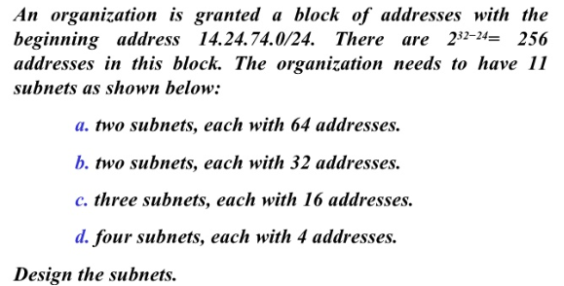
PROBLEM

Slide 27
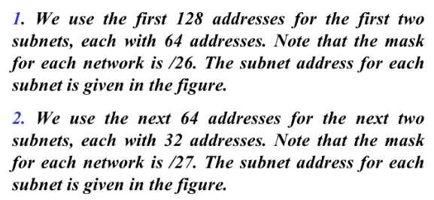
Solution

Slide 28
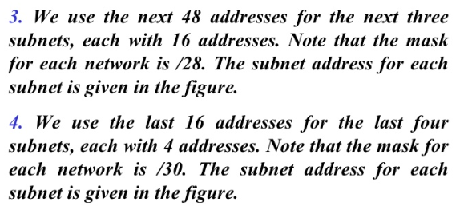
Cont.

Slide 29
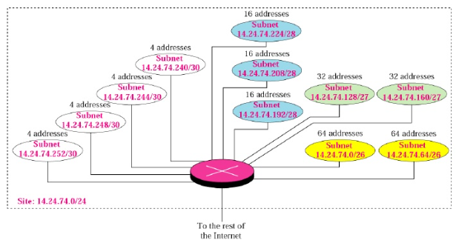
Cont.

Slide 30
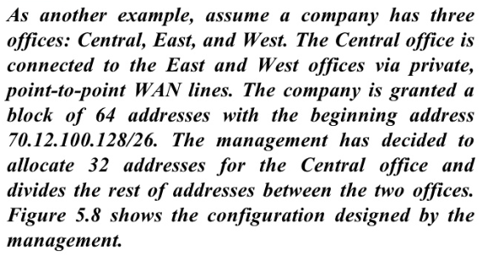
Problem

Slide 31
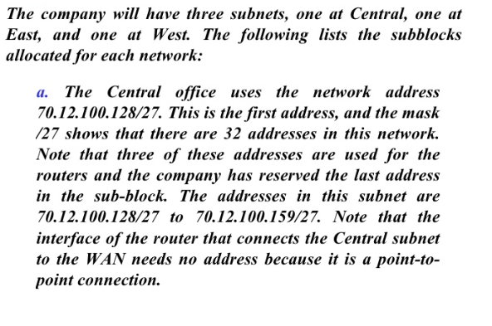
Solution

Slide 32
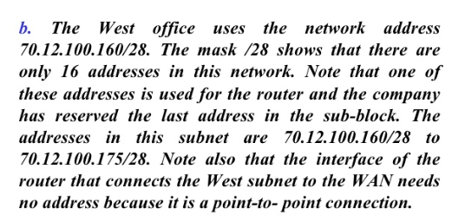
Solution

Slide 33
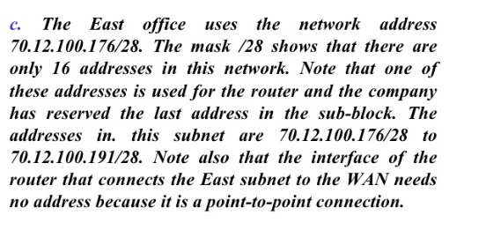
Solution

Slide 34
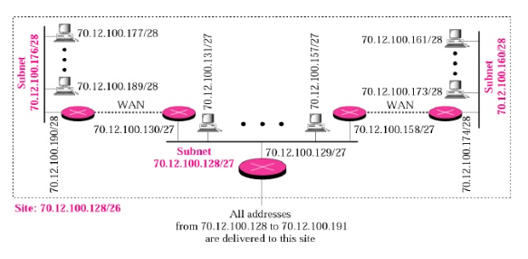
Solution

